Slide 1

Introducing Arduino
A Jumpstart to Programming
Your Surroundings
Presented by Arch Reactor

Slide 2
What’s an Arduino?
Arduino is an open-source electronics prototyping platform intended for artists, designers, hobbyists and anyone interested in creating interactive objects or environments.

Slide 3
What’s an Electronics protowatzit?
The Arduino platform is:
A physical board design
A programming environment
A development philosophy

Slide 4
What we’re doing today
load an existing program to the board
connect an electronic circuit
modify a sample program

Slide 5
Lets get started!

Slide 6
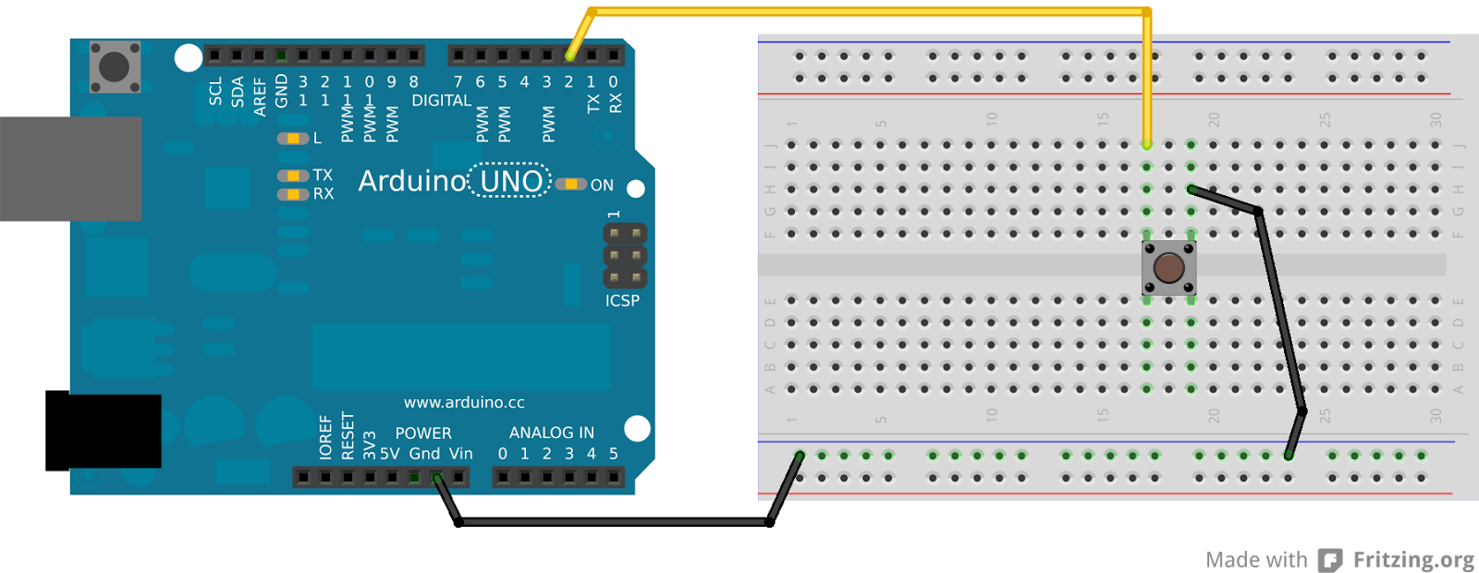
Button Example

Slide 7
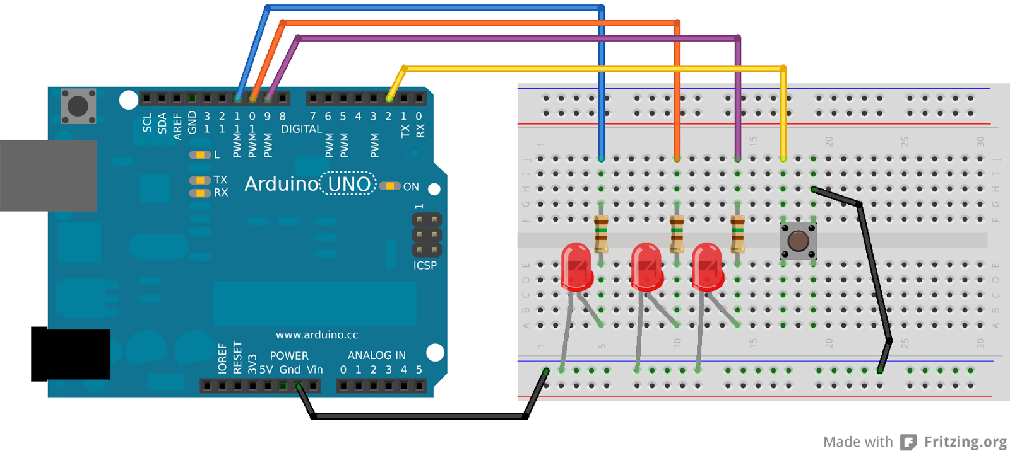
Add LEDs

Slide 8
What would you like to make?

Slide 9
Next Steps
http://arduino.cc/
http://www.instructables.com/
https://github.com/
Watch Arch Reactor’s calendar and discussion group for the next Arduino class
http://archreactor.org/

